Slide 1
Bubble Conference Website
Group 2
Leader: Yousra M. A. ALAKLOUK

Slide 2
How We Choose Our Open Source
Open-Source Name | Advantages | Disadvantages | Why we didn’t use it OR Why we used it
Big Blue Button | Open source for everyone we don’t have any copyright problems allows for everyone , easy to use nearly perfect open source | It’s perfect open source no need to add anything | We will not have many tasks until the end of the term
Open-Source from GitHub | Can start a meeting with 1 or more users | Difficult to start | we didn’t know how to start the program.
Open-Source from GitHub 2 | Just 1 to 1 so it doesn’t support many users | It doesn’t have a good interface, | We didn’t consider it since it is not supporting many users
Open-Source from GitHub 3 | Support many users Good interface Easy to use | We must add so many things | We chose it because it’s the perfect one to our project and we can do a lot of tasks all the term, we accept the challenge.
firstly, I made matrix to compare some open sources we found

Slide 3
Risks In Our Project
# General Risks:
No leader: Some people think its better to work as a partner, that is correct but at the end there must be a leader to refer to. Otherwise, the work will not be organized.
No plan: No plane to work on, no project to be completed.
Unknown deadline date: will lead to endless time and that will delay project delivery. Of course, that will get the customer angry and unsatisfied.
Assigning a task to the wrong member: for instance, assign teaching physics to art teacher. I don’t think the task will complete successfully.
Quit the group suddenly: will cause a huge miss on the group team because the will need to make a new plane.
Shortage of material or lack of money leads to refuse the project request or deliver it late

Slide 4
Risks In Our Project
# Specific risks
No end-to-end encryption
loss of personal user information.
complicated to use or maintain.
Meeting Hijacking allows the hacker to hack the database .
recorded meetings.6-Stolen meeting link.

Slide 5
Features We Have It Our Website
Interactive whiteboard
File sharing
Total privacy
Maximum security
Screen sharing
Webcam streaming
Chat room
Meeting recording

Slide 6
Functional Requirements
The user presses on Login or Register button
A new page pops up that shows register page.
If the user isn’t registered he will register.
The user will be redirected to terms and conditions page.
If the user agrees to the terms and conditions.
If the user is already registered he will login.
The user will be redirected to landing page for registered users.
View profile button can be pressed to view information.
The user can edit his/her information and press save changes.
A user can press log out to go the normal landing.

Slide 7
SRS Document
SRS
Introduction
System features
External interface requirements
Overall description

Slide 8
SRS Document
1. Introduction
1.1. Purpose : The purpose of this project is to learn how to manage a software project and improve an already existing video conferencing application.
1.2. Intended audience and reading suggestions : The focus will be on a video conferencing application which is used by people who want to meet online and it is open for use by everyone as there are no constriction for usage.
1.3. Project scope : We will learn how to work in a team, how to manage a project, give an estimation to tasks, work with scrum, divide the work evenly between team members. Also, this will be extremely useful for people who don’t have time or place to meet in person and it will be easy to share information and work on everything freely.
1.4. References and sources : https://krazytech.com/projects/sample-softwarerequirements-specificationsrs-report-airline-database , https://mirotalk.herokuapp.com

Slide 9
SRS Document
2. Overall description :
2.1. Product perspective : A video conferencing application stores the following information:
The name of the room and the name of the participants.
2.2. Product features :
• Giving the opportunity to hold important meetings in different countries short for money, effort, work and time
• High image & video resolution •
Clear voice when using the microphone • Should be easy app to use not complex .
2.3. User class and characteristics : Users should be able to choose a room name, choose their own name, give microphone and camera access, share files, share room link, and exit the room whenever they want.
2.4. Operating environment : • This application will run on heroku. • Javascript is the language used to code it.
2.5. Coding constraints : • Write as few lines as possible. • Use appropriate naming conventions. • Always write comments. • Segment blocks of code in the same section into paragraphs

Slide 10
SRS Document
3. System features
3.1. Functional requirements : • The user should write the room name and click join room.
• Popup should be showed asking the user for access to the microphone and the camera
• If the user doesn’t allow access to the microphone then he is redirected to another interface to try again.
• If the user allows access to the microphone and camera then he will enter his name.
4. External interface requirements
4.1. User interface requirements : 4.1.1. There will be screens showing every participant. 4.1.2. The upper part includes : 4.1.2.1. Timer. 4.1.2.2. Participant name. 4.1.2.3. Camera icon.
4.1.3. The left side includes : 4.1.3.1. Screen sharing 4.1.3.2. File sharing. 4.1.3.3. Camera turn off/on. 4.1.3.4. Mic turn on/off

Slide 11
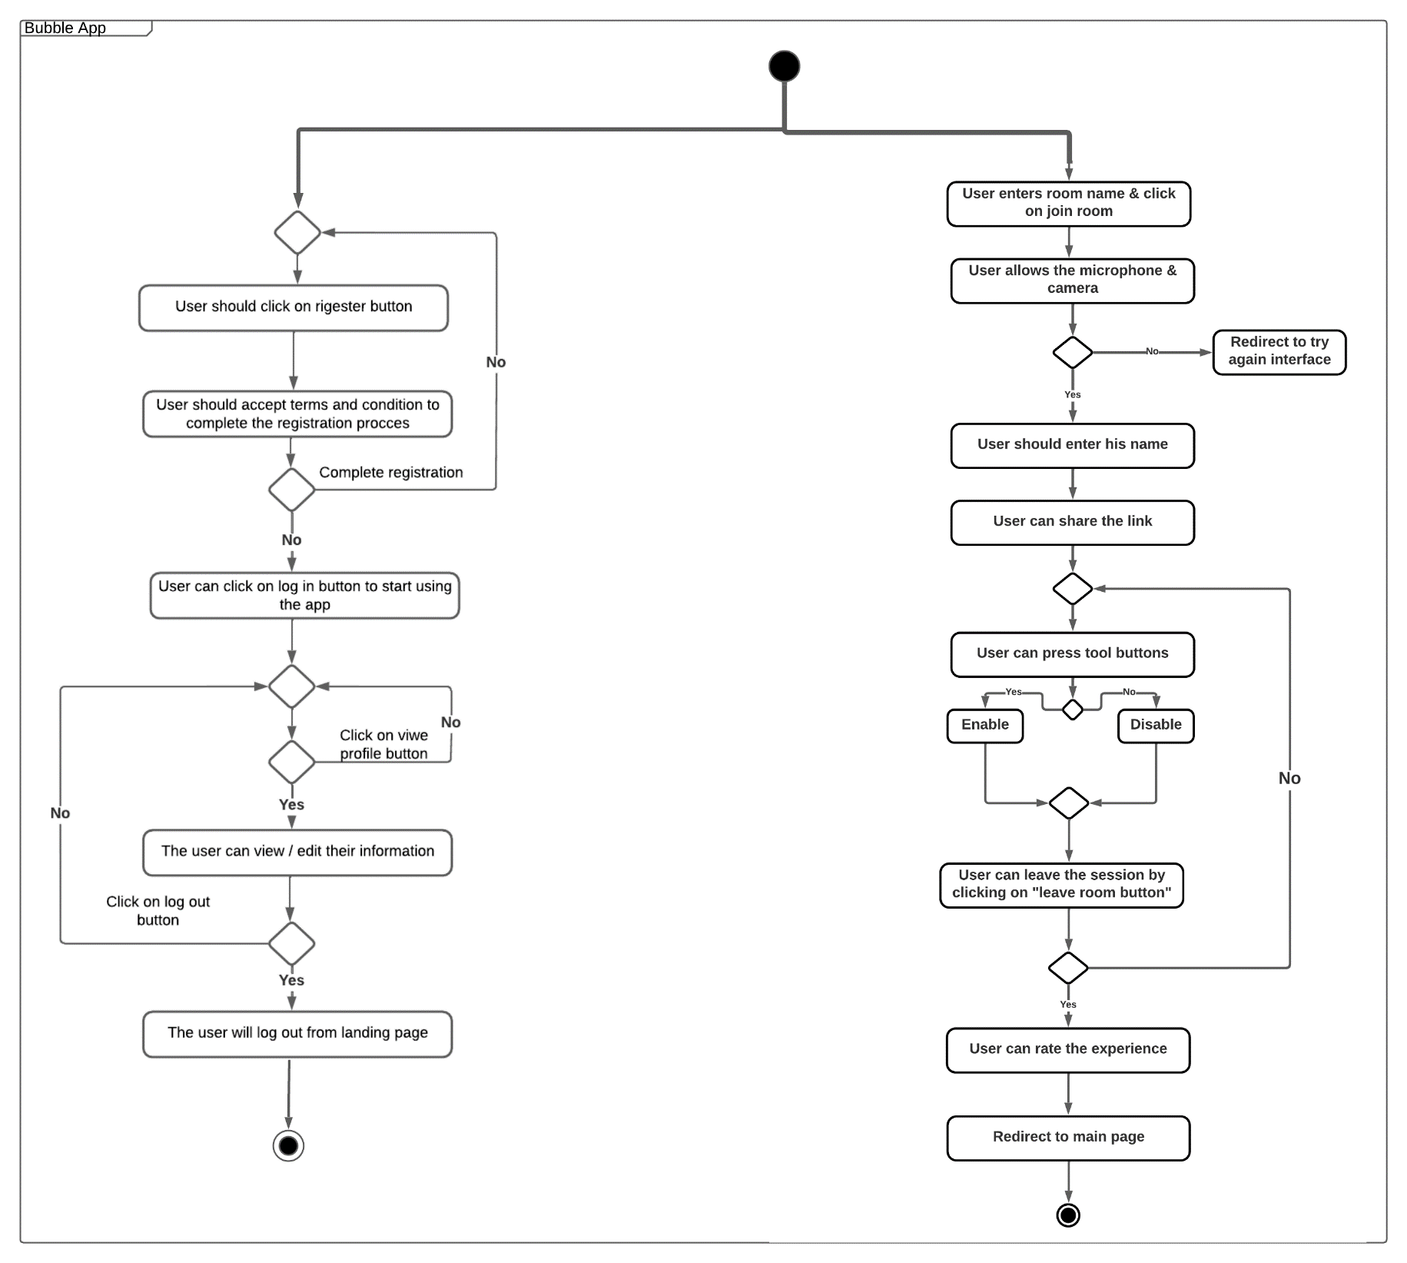
UML Diagram

Slide 12
Project Plan
Project plan should contain:
First, What’s a project plan?
(SOW): statement of work
Resource list
Project schedule
Work breakdown structure & Set of estimates
Risk plan “slide 3 and 4”
Defines the work that will be done on the project
Define who will do the work on the project

Slide 13
Project plan
1- SOW
is basically a shortcut for the sentence: statement of work, which describes all work products that will be produced and a list of people who will perform that work And, in our project, the work product that we will be produce is basically called Bubble app, and it is a free webRTC browser-based video calls, chat, and screen sharing, using google Stun and numb Turn. it provides video quality and latency that aren’t available in traditional technology. Since that SOW shows also a list of people who will perform the work\ project.
2- a resource list
should contain a list of all resources that will be needed for the product and their availability , and in our project , of course we have one resource for our web browser “Miro talk” which is
https://mirotalk.herokuapp.com/
also, in case of Commercial License or closed source, https://github.com/miroslavpejic85/mirotalk
And finally, our source code:
https://bubbleherokuapp.herokuapp.com/Landing

Slide 14
Project plan
3- work breakdown structure & set of estimates
a work breakdown structure is a simplification of all the work that should be done, that means that we should divide our work/ break it down to small pieces. And In our project, we meet together to divide each task for every member of us according to every member’s abilities and knowledge, and sometimes, if the task was so heavy or harder than one person can handle in our team, we “ our leader specifically” assign it to two of our team members, for example, in risks, the work assigned to 2 members not one, which they were manar and shrouq. Estimations are usually about the expectations about the time required to complete the software among the stakeholders, the team, and the organization’s management. So, in our project, we created a project schedule that contains the estimation time required for every task to be done, in addition to other information too.
There’s also some expectations about our project, such as:
fully running application on computers browsers (responsive) -1
it supports more than different browser -2
we also expect it to provide the maximum security, by using End-to-end state-of-the-art -3 encryption technique

Slide 15
Project Schedule
Date | Week | Task | Assigned to | Done | Estimated time | Actual time
3-3-2022 | Week1 | - | - | - | - | -
10-3-2022 | Week2 | Choose the team | All | yes | A week | A week
 |  | Choose the leader
 |  | Understand the project
 |  | Search for open sources
17-3-2022 | Week3 | A matrix for the open sources that we found, advantages and disadvantages for each one, why we did and didn’t use it | Yousra | Yes | 2 hours | 1hour and half
 |  | Requirement | Sama | Yes | 1hour | 1 hour
 |  | Features that we have, and we will add | Mesaab | Yes | 1hour | 1 hour
 |  | What do we expect from our project | Abdulaziz | Yes | 1 hour | 1hour
 |  | Risk we have and we expect to have in the future | Manar Hasan and shurooq | Yes | 1 hour | 1 hour
 |  | Copyright issues | Manar Tariq | Yes | 1 and half hour | 1 hour
24-3-2022 | Week4 | Draw UML diagrams | Manar Hasan | Yes | 3 hours | 2 hours
 |  | Project schedule, check the code the design of the code | Yousra | Yes | 2 hours | 1 and half hours
 |  | Working on style | Abdulaziz | Yes | 3 hours | 30 minutes
 |  | Project plan document | Manar tariq | Yes | 2 hours | 3 hours
 |  | Vision and scop document (problem statement) | Shurooq | Yes | 1 hour | 1 hour
 |  | Vision and scope document (vision of the solution) | Mesaab | Yes | 1 hour | 1 hour
 |  | search about the available platforms and choose which one is better for us and why did you choose it | Sama | yes | 3 hours | 1 hour
31-3-2022 | Week 5 | Setting the video call (pair programming) | Manar Hasan and Mesaab | Yes | 4 hours | 2hours
 |  | SRS documentation | Sama and Manar Tariq | Yes | 2 hours | 2hours
 |  | Fixing the chat (pair programming) | Abdulaziz and Yousra | Yes | 3 hours | 3 hours
 |  | Review the program | Shurooq | Yes | 1 hour | 1 hour
07-04-2022 | Week 6 | Searching how we can upload our project on heroku | Sama | Yes | 2 hours | 2 hours
 |  | Start searching what we should include to our project | Manar Tariq | Yes | 1 hour | 1 hour
 |  | Change the entire interface (put our mark on it) | Abdulaziz, Manar Hasan, Yousra | 5 hours | 6 hours
 |  | Test the changes on chat box | Shuroq | Yes | 1 hour | 1 hour
 |  | Test the program in the mobile version | Mesaab | Yes | 1 hour | 1 hour
14-04-2022 | Week 7 | Gathering information for login and searching how linking can be done | Abdulaziz , Yousra | Yes | 3 hours | 3 hours
 |  | Search what we need to make our program to mobile version | Mesaab | Yes | 2 hours | 2 hours
 |  | Edit the share link page | Sama | Yes | 1 hour | 1 hour
 |  | Design new logo for our program and find a new name | Manar Tariq | Yes | 2 hours | 2 hours
 |  | Search for a database that we can use it in our program, why we chose it and how much time is needed to design and link it | Manar Hasan and Shurooq | Yes | 3 hours | 3 hours
21-04-2022 | Week 8 | Midterm week
28-04-2022 | Week 9 | Design the login and register pages | Yousra and Abdulaziz | Yes | 3 hours | 4 hours
 |  | How we can pin/unpin feature?, what we need?, how much time it will take? What is it? what its benefit to our program? why we did consider this feature? | Manar Tariq and Mesaab | Yes | 2 hours | 2 hours
 |  | Check the design after implementing | Sama | Yes | 1 hour | 1 hour
 |  | Learn about MongoDB | Manar Hasan and Shurooq | Yes | 2 hours | 2 hours
 |  | Implement pin/unpin feature | Manar Tariq | No | 0 | 0
05-05-2022 | Week 10 | Holiday
12-05-2022 | Week 11 | Design view profile page and edit profile page | Yousra | Yes | 2 hours | 2 hours
 |  | Make a video describing our app. How it can be used, what its features. Etc | Abdulaziz | Yes | 1 hour | 1 hour
 |  | New interface page for registered user( contain logout , profile button ) | Sama | Yes | 1 hour | 1 hour
 |  | Design database for profile page and login, register page on MongoDB using localhost | Manar Hasan Shurooq | Yes | 2 hours | 2 hours
 |  | Learn how to link the database with the visual studio code |  | Yes | 3 hours | 3 hours
 |  | Design welcome page | Mesaab | No | 0 | 0
 |  |  | Manar Tariq | Yes | 2 hours | 2 hours
19-05-2022 | Week 12 | Holiday
26-05-2022 | Week 13 | Edit and organize our GitHub repository | Manar Tariq | Yes | 2 hours | 2 hours
 |  | Prepare the report | All | Yes | 3 hours | 3 hours
 |  | Prepare the presentation | All | Yes | 4 hours | 4 hours
 |  | Test the program | All | Yes | 6 hours | 6 hours
 |  | Complete the project schedule | Yousra | Yes | 1 hour | 1 hour
 |  | Link the database to the cloud | Manar Hasan , shurooq | Yes | 2 hours | 1 hour
 |  | register and login, and view profile and edit profile page, learn how to link it to the cloud |  | NO | 2 hours | 5 hours and couldn’t do it
 |  | Upload the last version of the program on Heroku | Sama | Yes | 1 hour | hour
Open The Word Document

Slide 16
Code Style
There are some standards(concepts) that we should follow so we can write a good code that have a good style.

Slide 17
Code Style
Always remember KSS (Keep it Stupid, Simple) principle.
Architecture is needed before coding.
Write as few lines as possible.
Use appropriate naming conventions.
Always write comments.
Use indentation to marks the beginning and end of control structures.
Clearly specify the code between them.

Slide 18
Code Style
Don’t use lengthy functions. Ideally, a single function should carry out a single task.
Use the DRY (Don’t Repeat Yourself) principle. Automate repetitive tasks whenever necessary. The same piece of code should not be repeated in the script.
Avoid Deep Nesting. Too many nesting levels make code harder to read and follow.
Avoid long lines. It is easier for humans to read blocks of lines that are horizontally short and vertically long.
Notes:
In general, something that is nested is fully contained within something else of the same kind. In programming, nested describes code that performs a particular function and that is contained within code that performs a broader function. One well-known example is the procedure known as the nested do-loop.

Slide 19

Logo, And How We Chose It
1- the idea of our logo:
our logo name is inspired by "bubble talk" icon, which can be used to represent the chat flowing between people.
And since our project is all about communicating in all of its forms, we decided to represent that communication by a visual shape, which is "bubble"
2- color pattern:
Our color pattern is pink color which classified as one of an eye-comforting colors.
Also, as our interface “home page” colors been choose as: purple and blue, so the selection of our logo colors were based on these 2 colors, so it can fit them.

Slide 20
Heroku
Heroku is a cloud platform as a service supporting several programming languages, we used it to deploy our app on the cloud because we decided to run it on the cloud and not locally.
We can always make our own server, but we chose Heroku because it is easier, not costly, takes less time and it is better for small projects such as ours.
It was very easy to deploy it to Heroku, on their website they have everything covered and have a step-by-step tutorial on how to do it from the start to the end.

Slide 21
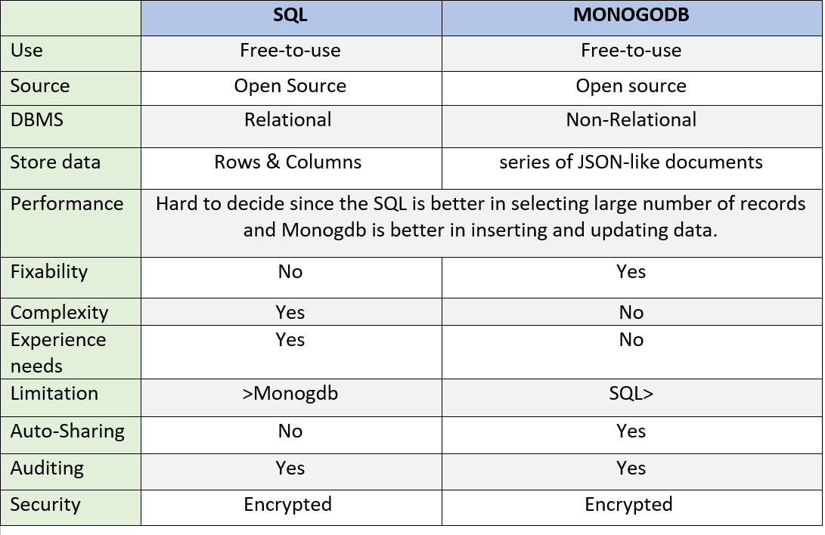
Mongo DB , Why We Chose It

Slide 22
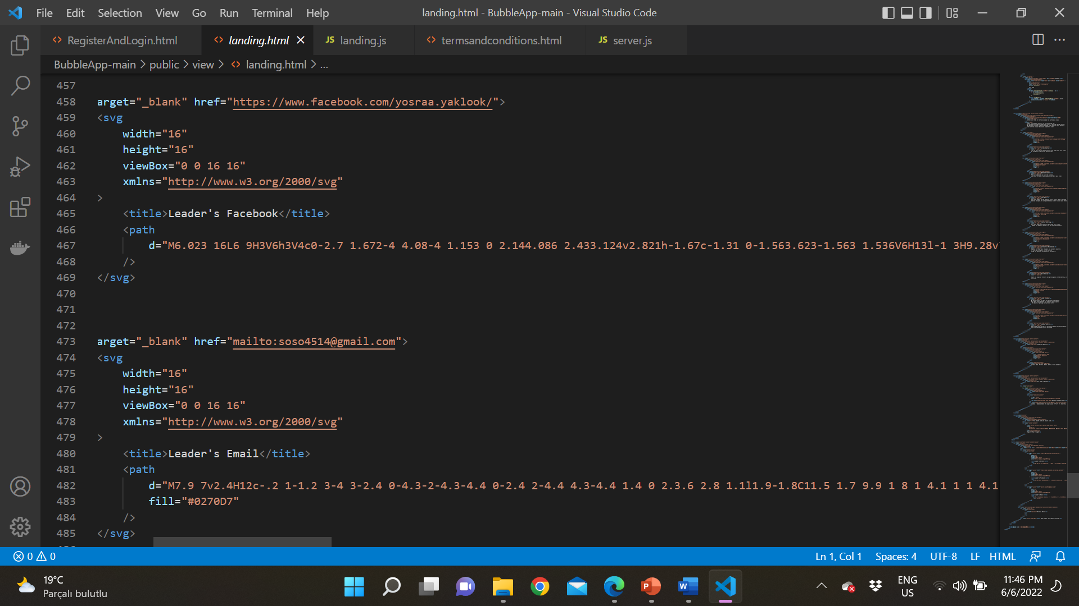
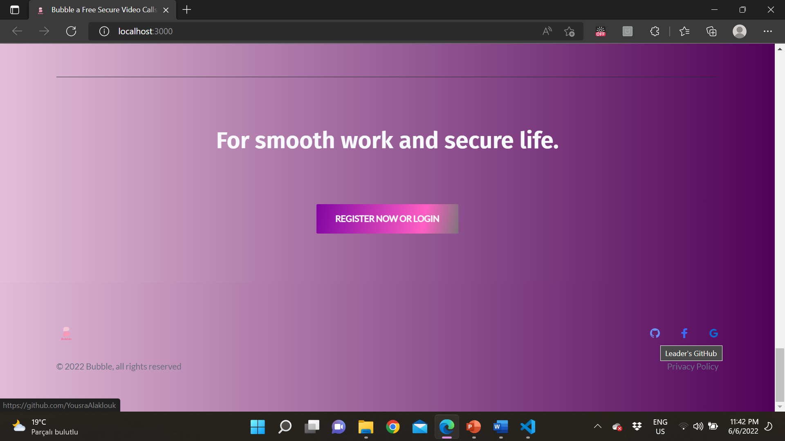
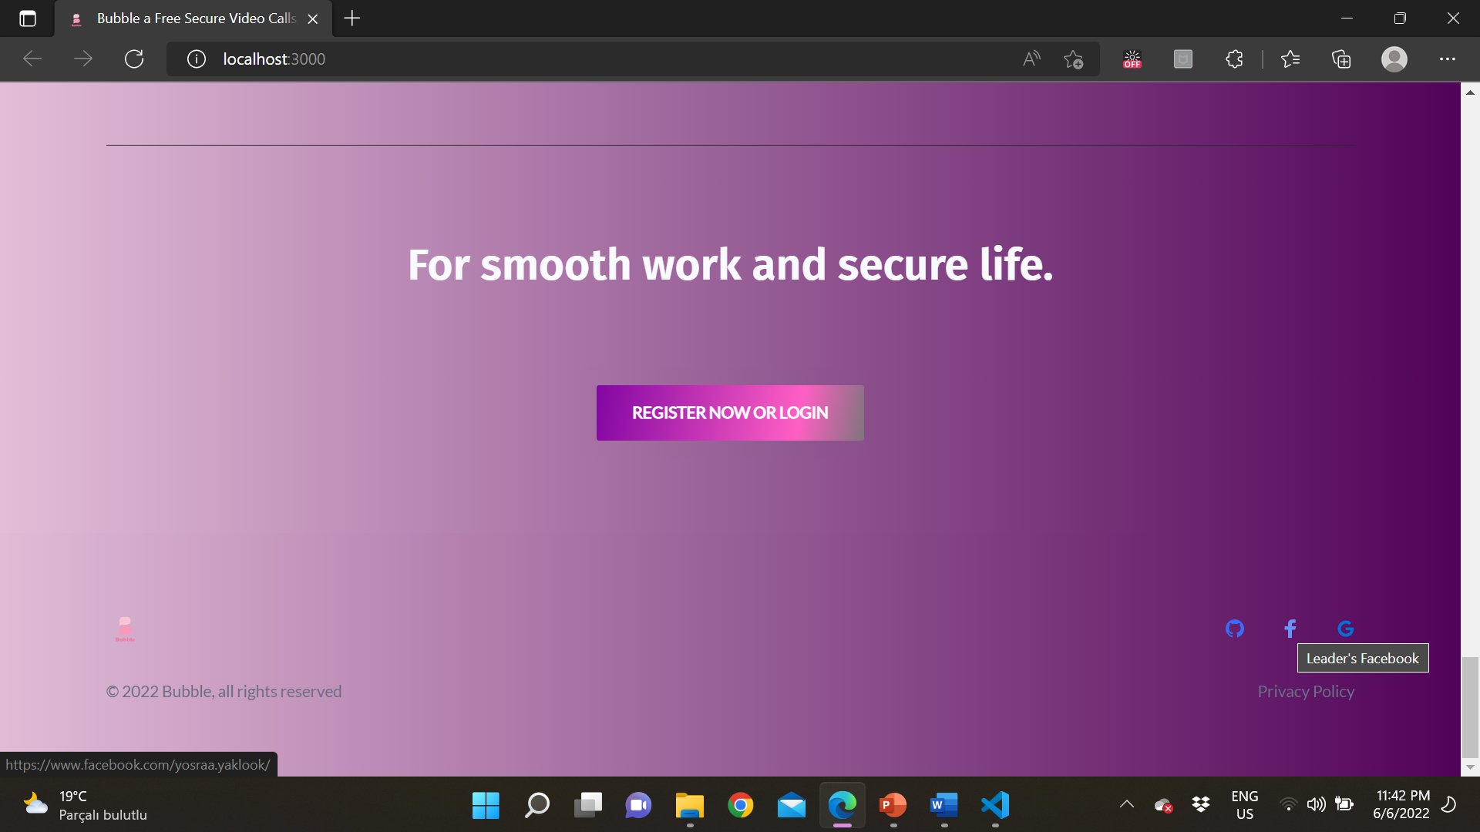
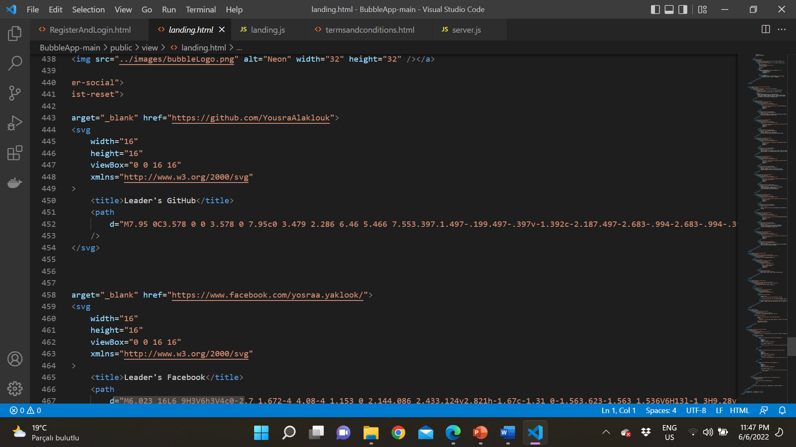
How We Connect Our Program To many website
We Did Connect Our Website To the GitHub, Facebook and Email using HTML code
anyone can easily connect us when ever he/she wants because in every page in our website in the footer they can click on the one of the icons and contact us

Slide 23
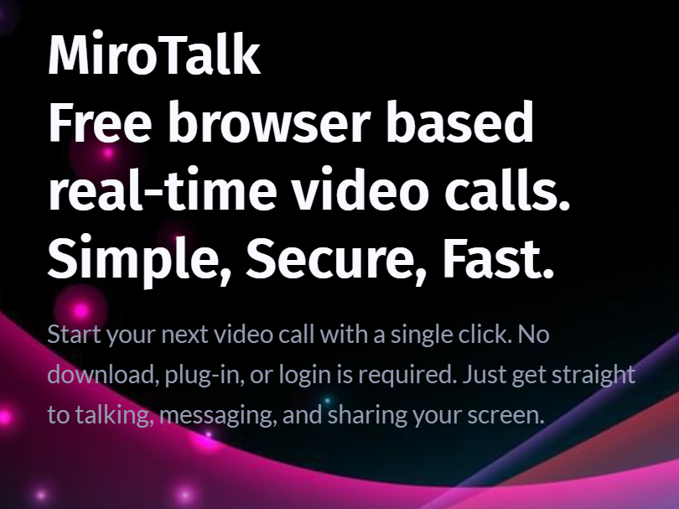
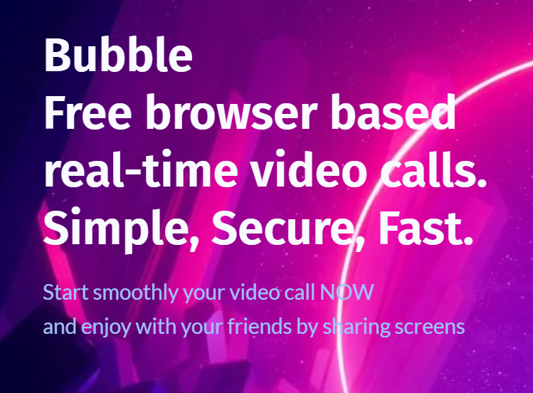
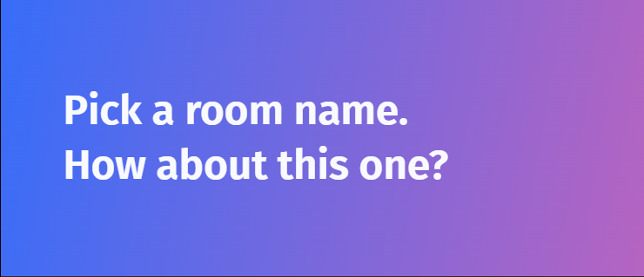
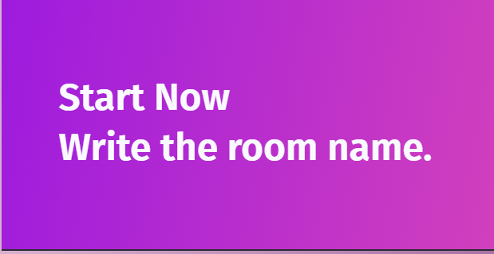
Interface Design Before And After
WE have made some changing on the interface description and this is only example ” Not all changes”

Slide 24
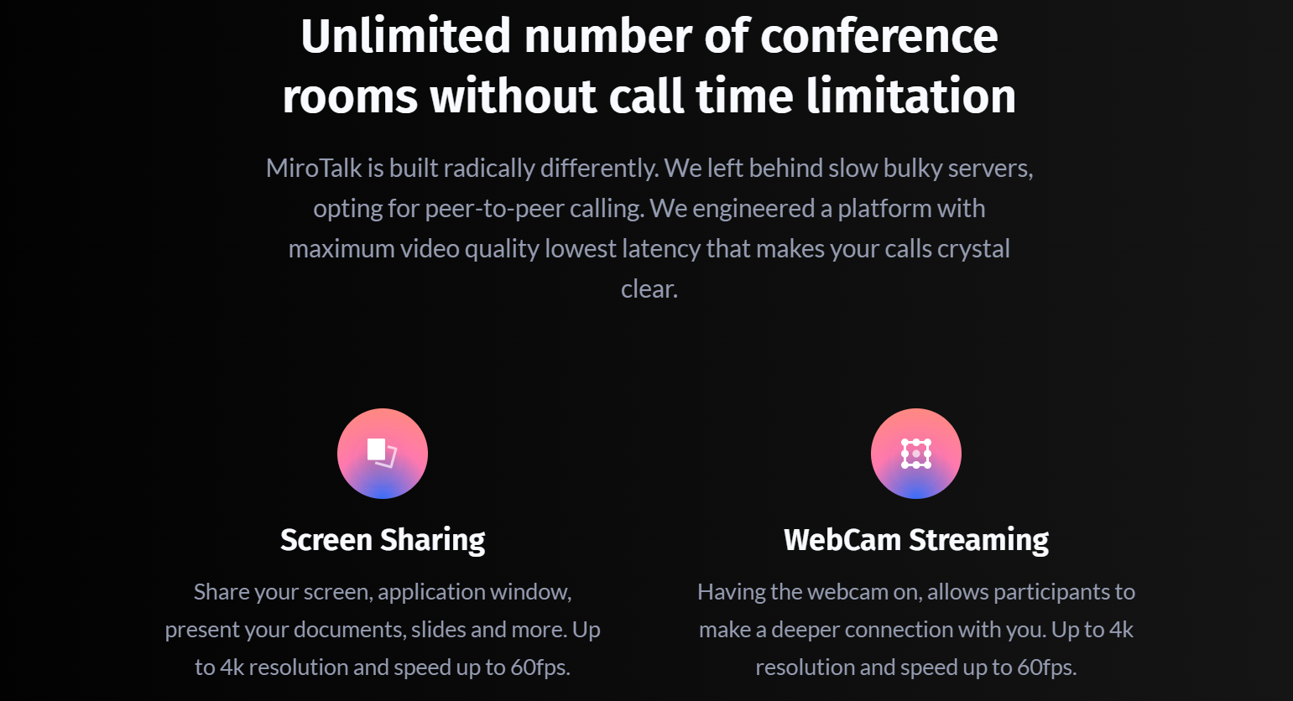
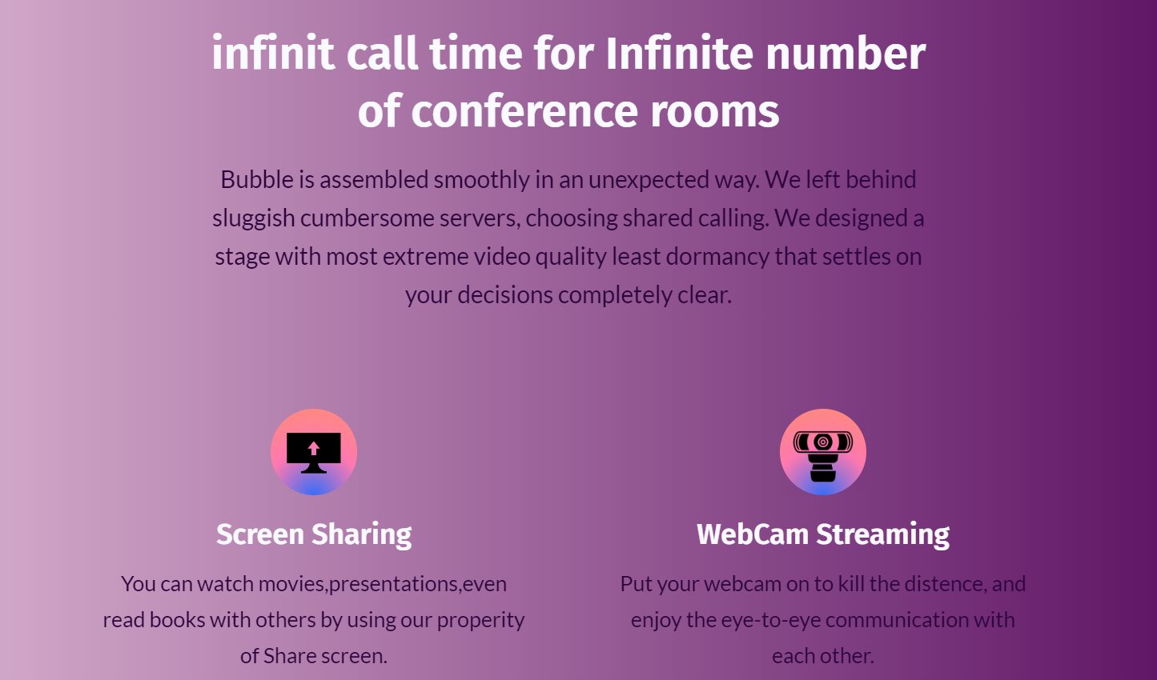
WE have made some changing on the interface description and icons too and this is only example ” Not all changes”

Slide 25
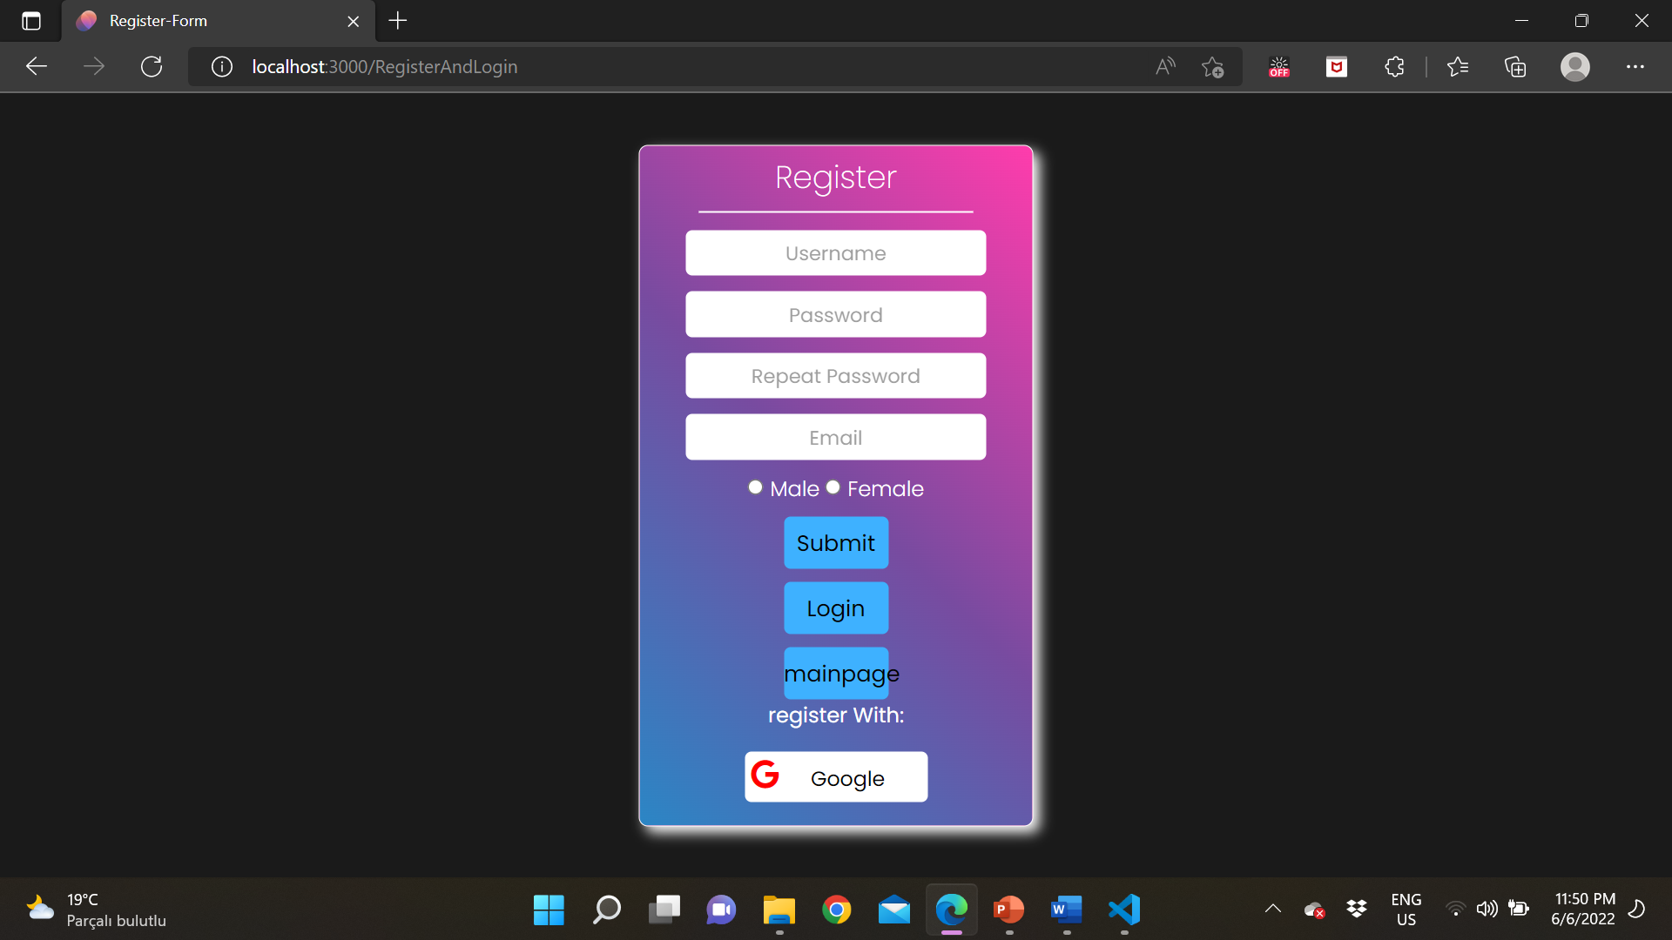
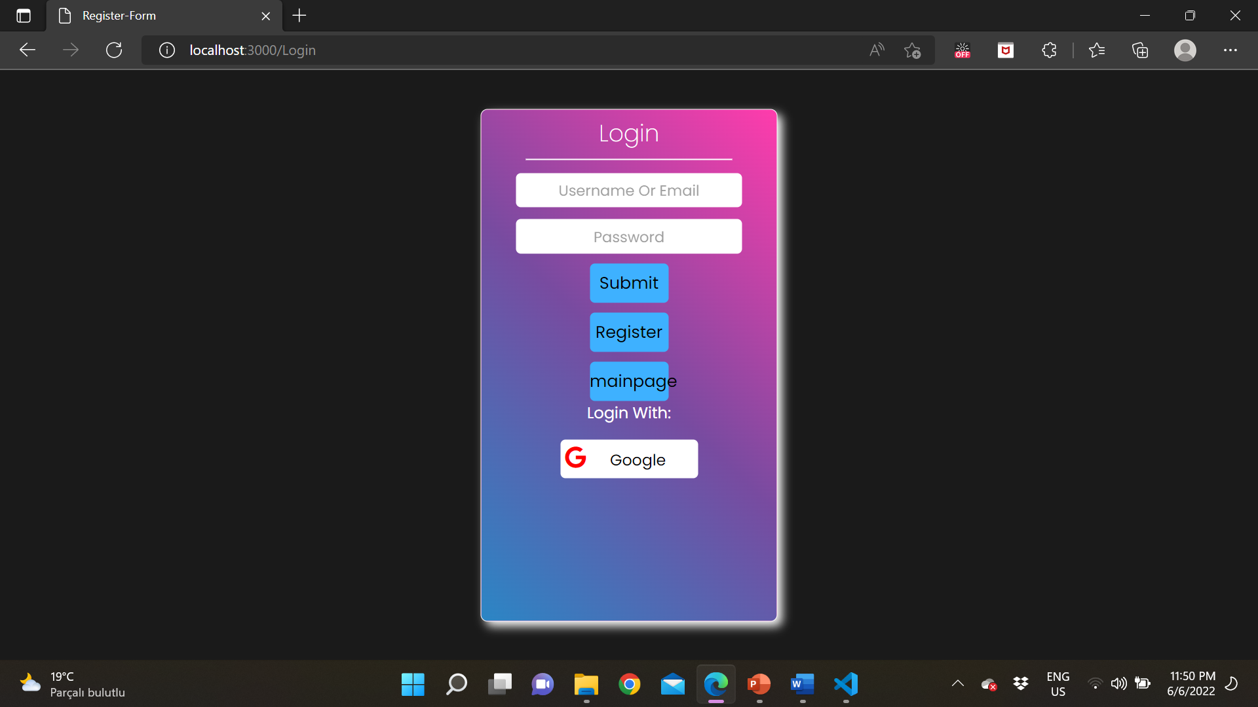
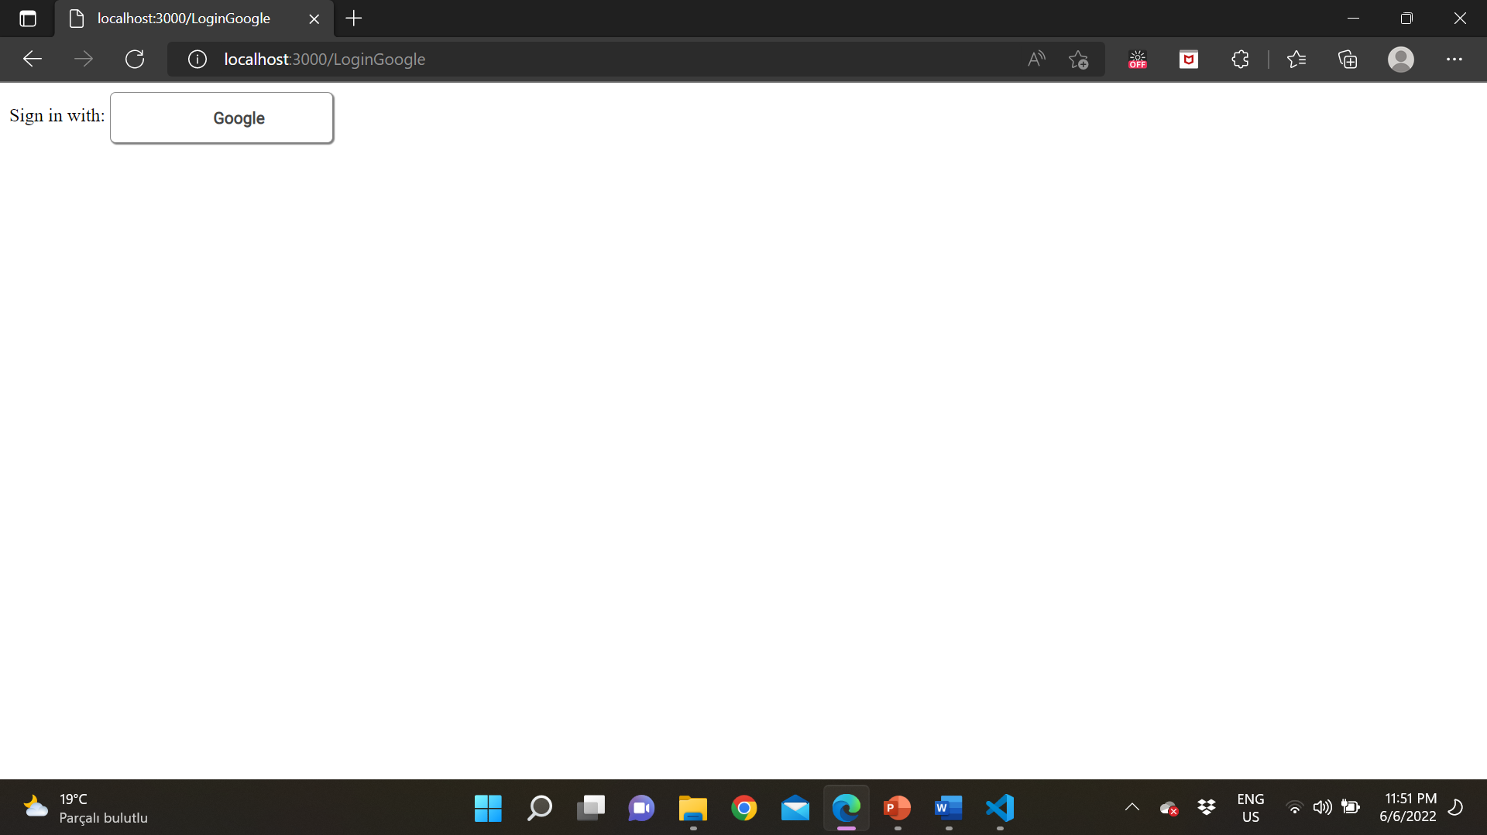
Register And Login Design
You Can Login Or Register Using Google too!

Slide 26
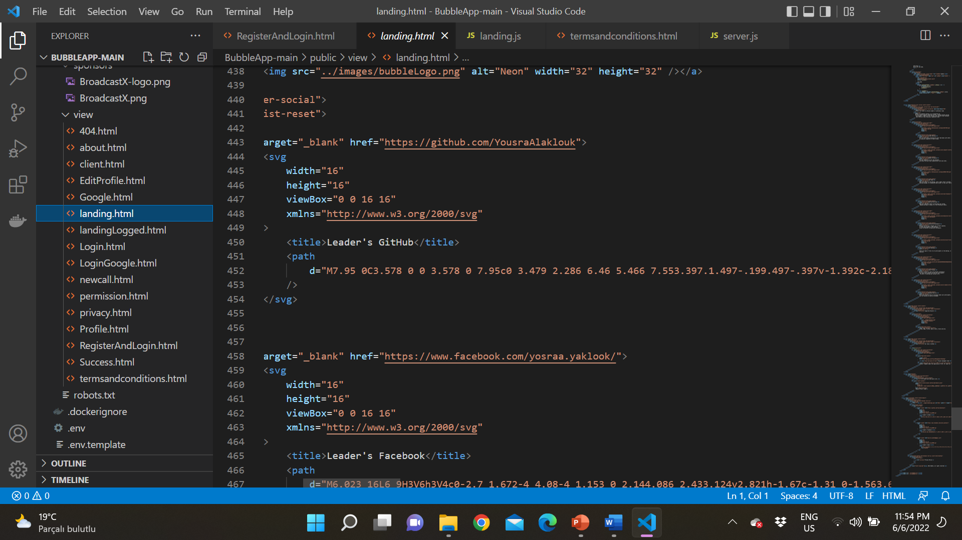
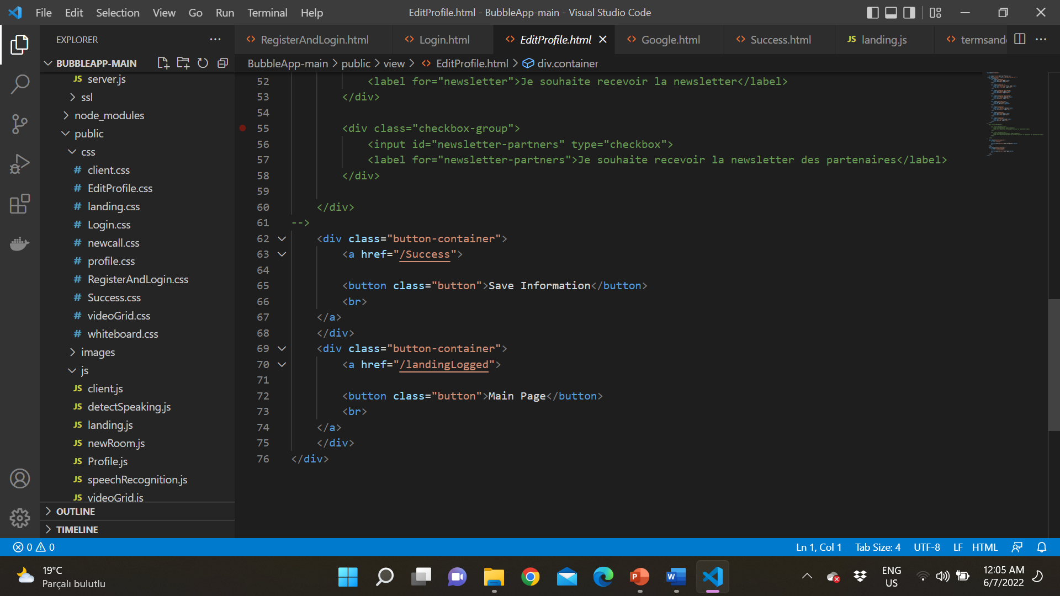

Login And Register Code
We used HTML and css for login and register
We user HTML for the programming things and css for design , we used java script as well for the server
The connection between our app and google
Login page(The Design too)
The Google page After click sign in or signup using google
The Register Page(The Design too)

Slide 27
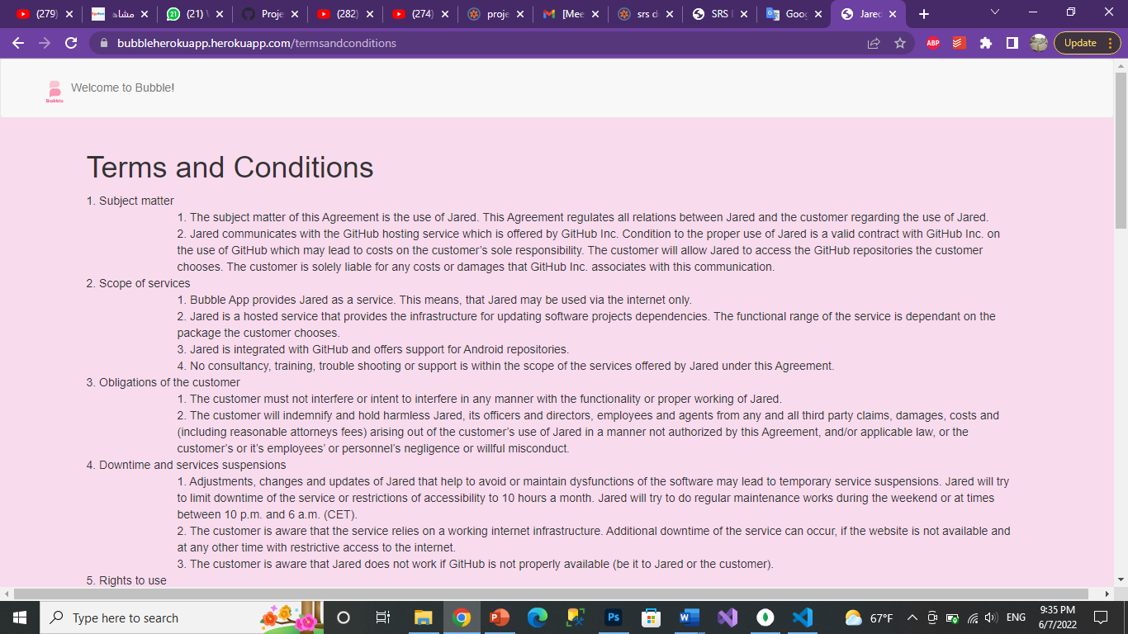
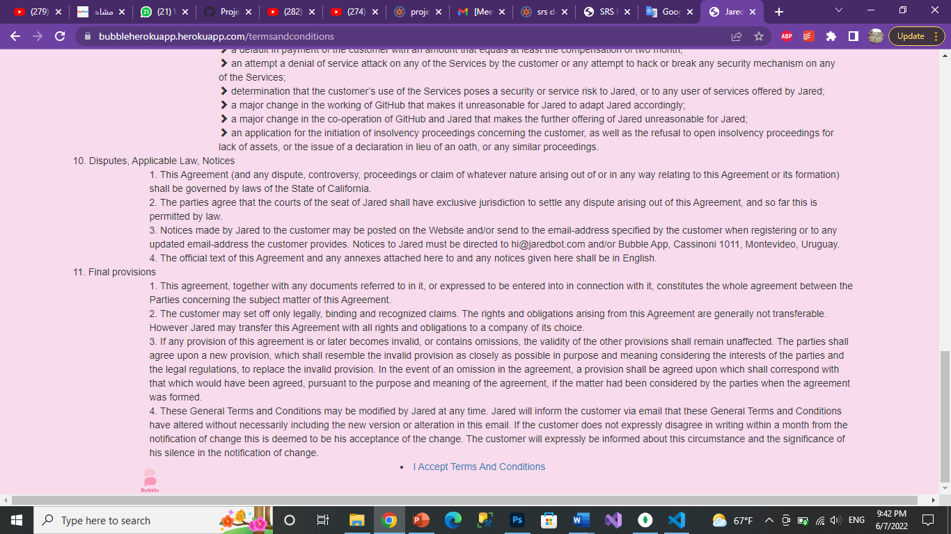
Terms And Conditions
How it works and when it appears?
After Logging in, the user will have a choice to either submit or go to the main page. And then, after choosing to submit, it will take the user to terms and conditions.
After submitting the Terms and conditions page will appear. If the user accepted the terms and conditions, it will take him to the main page.
An example about it “from our project/website”
Title
Subject matter
Scope of services
Acceptance button
Obligations of the customer

Slide 28
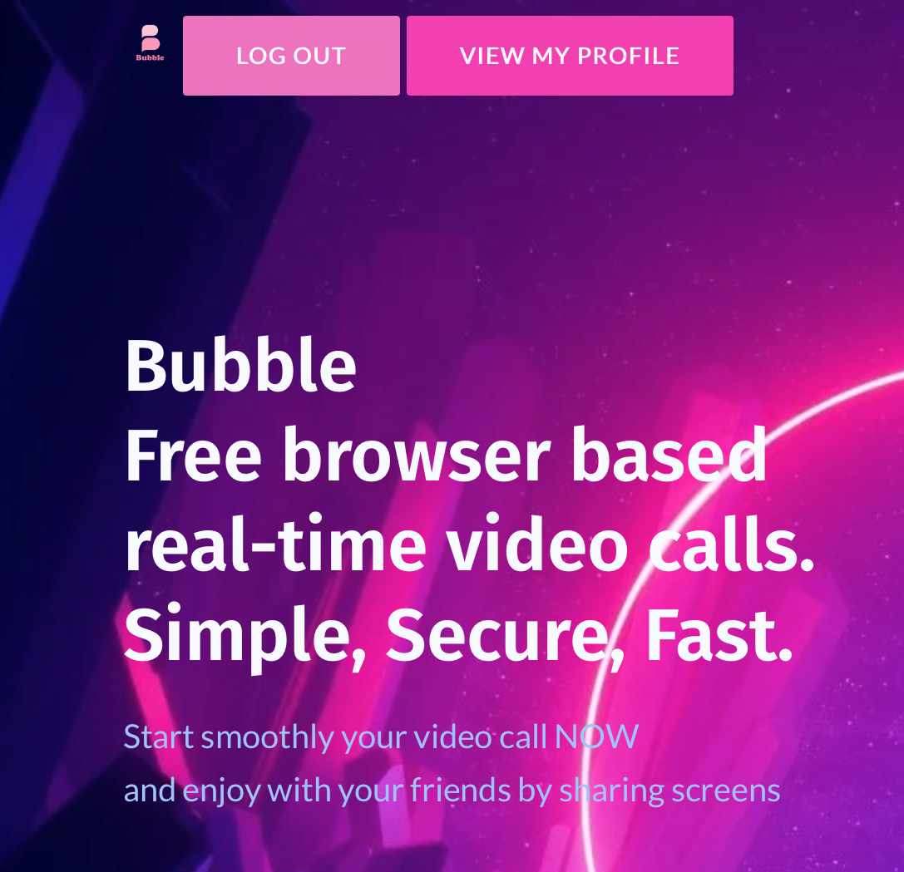
Interface For Registered
When the user logs in the program redirects to the landing for the registered users.
View my profile button shows the profile and enables the user to view and edit his own information.
If the user presses logout he will no longer be able to view the profile and edit it.
These buttons were implemented in HTML.

Slide 29
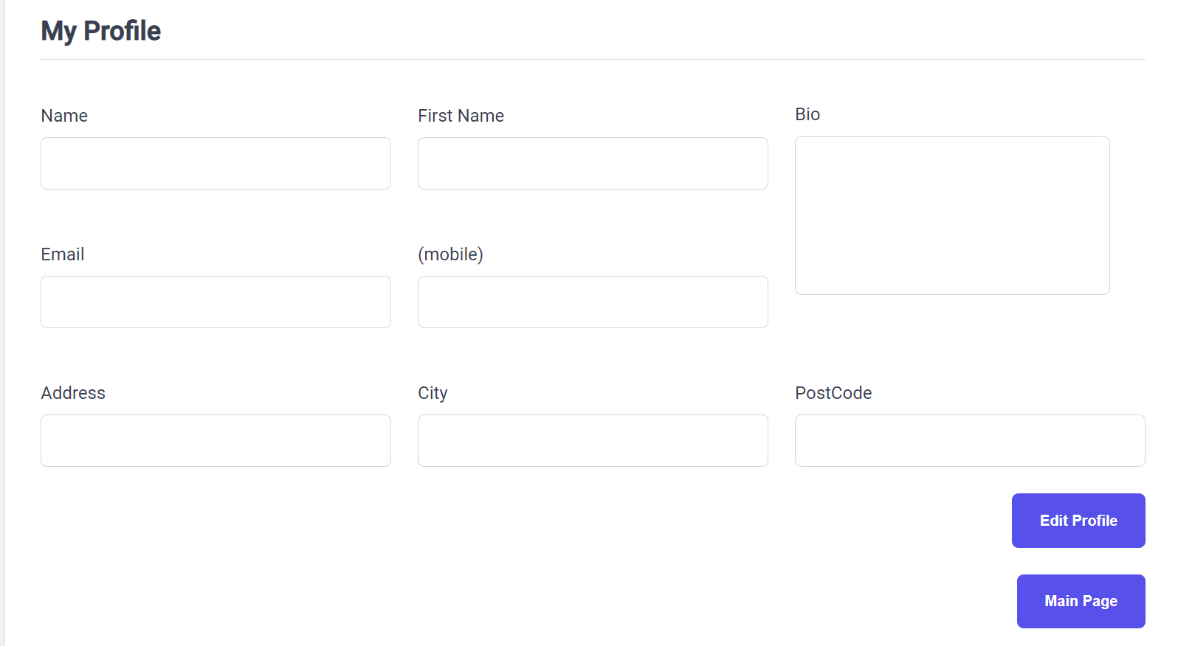
View Profile
Click here to edit the profile
Click here to go back to the main page

Slide 30
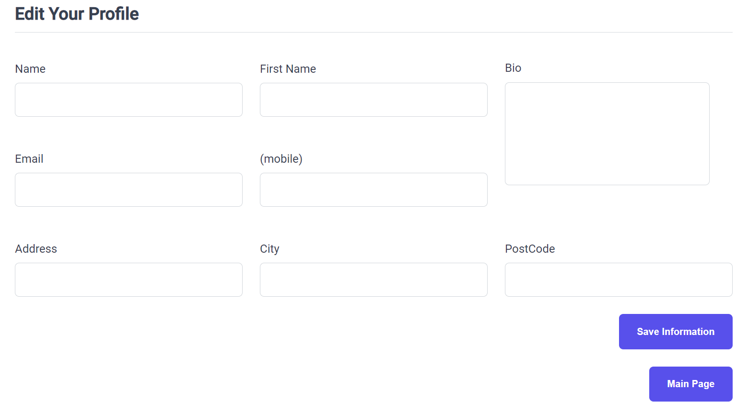
Edit Profile
To Save The Information You added

Slide 31
features We wanted to implement but we couldn’t
Pin/unpin feature
Pin and union feature is one of the things that couldn’t be implemented in our project because of these reasons:
- Not being familiar enough with the language: since that the used language to create our website is javascript, I wasn't have enough knowledge with it which caused a difficulty that required learning about that language first.
not having enough resources that explains how to implement that feature, which cause another difficulty, hours and hours of hard searching
2. Transforming to Mobile app
We couldn’t do it because it needs a lot of work , budget , time ,effort , and also we need to subscribe to a specific programs to help us transform our program to a mobile app and take some training for using them
3. Dragging file in to the chat
I couldn’t because I didn’t have enough background about JavaScript

Slide 32
As A Project Manager
As a project manager I learned:
How to manage the project time.
Finding my team's Knowledge & Skills (which language do they know, what they are capable of doing).
Giving my team tasks that matches their knowledge and skills
How to solve problems.
Multitasking. (Sometimes I was doing my tasks and I was also helping some team members in their tasks as well).
Ability to make decisions under pressure.
I found some difficulties:
when I was searching for some tasks
Deal with some members

Slide 33
Bubble Project Video

Slide 35
Thank you for Listening

